Slide 1


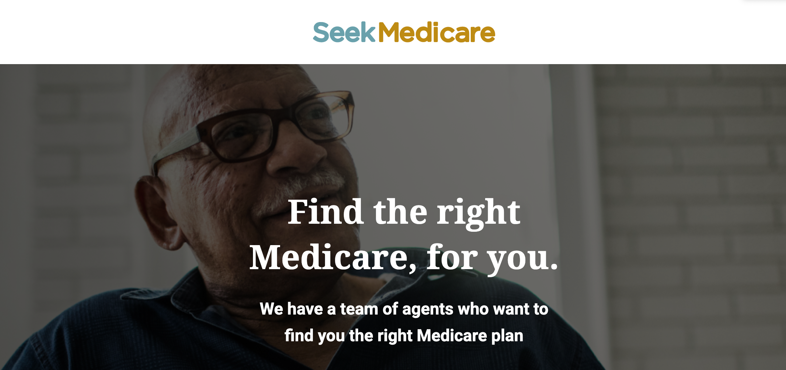
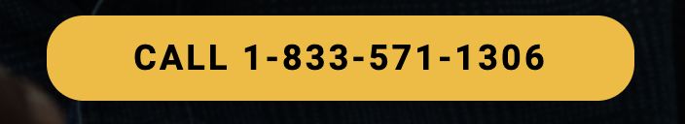
SEEK MEDICARE™
Who Are We?
Notes:
The Overview:
We are a startup Medicare insurance agency with a huge mission to revolutionize the way people select coverage and experience the decision-making process around matching people to the right health insurance coverage. We use innovative technology and a modernized interactive process.
In short, we are a high-performing, consumer-centric, Medicare contact center sales operation.
Our startup organization is a group of experienced healthcare executives along with a supporting team of energetic professionals with a passion for providing solutions for our customers and stakeholders.

Slide 2

About Our Company:
We are on a huge mission to revolutionize the way people select coverage and experience the decision-making process around matching people to the right health insurance coverage using innovative technology and a modernized interactive process.
Notes:
The Mission:
We want to streamline the process and ease the stress and complication of enrolling and shopping for Medicare plans for our consumers.

Slide 3
Our Value Proposition To You:
You Become A Member of A Team of
Industry Experts
Your Time Can be Better
Spent on Providing
Your Client With a
Quality Medicare Plan
Receive Online Support and Guidance
We’ll Bring You
New Qualified Medicare Prospects
SEEK MEDICARE™
Notes:
The Benefits of a SeekMedicare Agent:
We will vet calls and transfer interested and qualified prospects to you.
You’ll get access to our client-portal and software platform that gives you all the information you need to be successful.
You will become part of the SeekMedicare Team with access to a community of experts.
More importantly, your time can be spent providing the Medicare plan that suit the needs of your client.

Slide 4
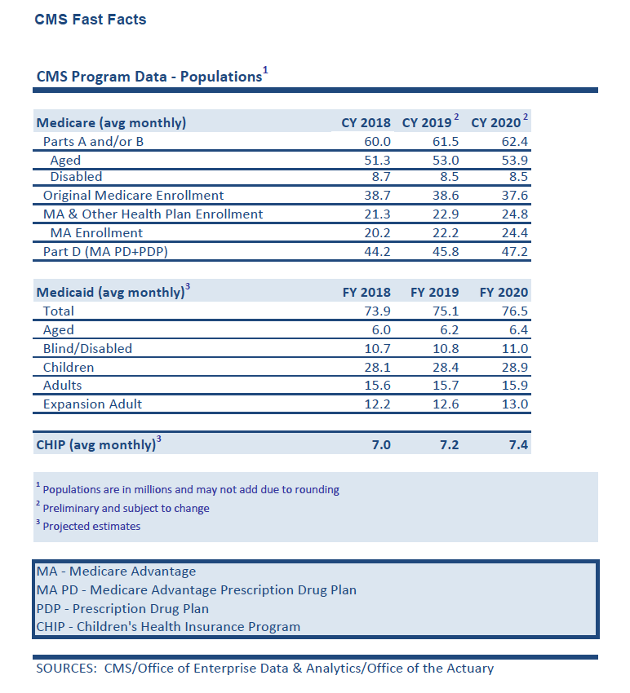
As of July 2020, the CMS reported over 62 million are enrolled in Medicare A and/or B.
SOURCES: CMS/Office of Enterprise Data & Analytics/Office of the Actuary
SEEK MEDICARE™
Notes:
The elderly population is growing at a tremendous rate. According to Pew Research & the AARP, roughly 10,000 individuals are Turning 65 (T65) every day.
The Medicare clientele is projected to increase to over 80 million beneficiaries by 2030, as the Baby-Boomer generation ages into Medicare. This expansion will bring changes to the Medicare population.

Slide 5



Baby Boomers Represent Nearly 20% of the Current American Public.
SEEK MEDICARE™
Notes:
Baby Boomers (born between 1946-1964), have a significant impact on the economy. As a result, they are often the focus of marketing campaigns and business plans.
Baby Boomers hold $2.6 trillion in buying power. They’re credited as one of the wealthiest generations to date.
According to Forbes, statistics show that approximately 70% of all disposable income in the U.S. belongs to Baby Boomers, and they make up the largest segment of consumers.
As a long-living customer base, American Baby Boomers are expected to live 10 to 25 years longer than their parents did.
Also according to Forbes, marketing toward Boomers requires a dynamic approach that will continue to need adapting over the years. This is a practical generation that likes to keep things simple, but is also getting ready for retirement and ready to indulge in a comfortable, well-deserved life.

Slide 6
Word of Mouth
What’s Your Strategy
To Get New Medicare Business?
Website
Print Media
Cold Calling
Social Media
Direct Mailings
Seminars
Pop-Up Retail Events
SEEK MEDICARE™
Notes:
Your clients are important to you. You want them to feel confident in you and your guidance to help them choose the right Medicare plan. They need you to listen to them and understand their unique needs. In the end, you will have a loyal customer and the opportunity to cross-sell them on other products as well.
However, the market is changing and the way we buy insurance is changing as well. The traditional way of marketing via cold calling, direct mailing and listings are sometimes a shot in the dark to get qualified prospects. These are passive marketing approaches in this digital age. It’s getting harder to organically grow your business through these traditional methods. People are more likely to use the internet to search for information and are more reliant on the technology in hand to get it done efficiently. The ‘technically challenged’ even rely on their children or grandchildren to do the research for them on important issues and changing information.
More then likely, if a prospect is seeking a Medicare plan and comes directly to you, the ability to close the deal will be more guaranteed then the passive marketing approach and will cost much less.
And that’s what SeekMedicare does, we bring the interested and qualified prospect to you.

Slide 7


How Much
Money And
Time Are
You Spending on Getting New
Prospects?
SEEK MEDICARE™
Notes:
Let’s think about how you market Medicare now.
Here’s some questions to ask yourself.
How many hours do you market to prospect for Medicare clients?
How many hours are you out there pounding the pavement?
Are you currently restricted in this type of selling because of Covid-19?
How many hours/days do you cold call?
How much time are you using to market the Turning 65 market? Are you starting early enough?
Are you hosting educational seminars and webinars?
Do you have the time for all this?
How much money do you spend on marketing materials?
How much are spending on mailing lists?
Do you have qualified leads?
Are you current with CMS marketing compliance?
What’s your ROI / response rate on traditional marketing methods? (less then 2%)

Slide 8


Health Care is Changing.
Your Competition is Increasing.
SEEK MEDICARE™
Notes:
Question: How Do You Stand Out in This Market?
Effective Branding takes a long time and a lot of money.
Ask yourself:
Are prospects looking for you?
Have there been missed opportunities?
Can your valuable time be better spent somewhere else?
There are over 60K Medicare agents (insurance.com).
Why?
Medicare contracted companies hire independent agents/brokers who are not employees to sell the companies' Medicare plans.
The residual income is attractive with opportunity to sell cross platform products.

Slide 9

We Have To Change the Way We Sell Medicare Plans Right Now.
SEEK MEDICARE™
Notes:
The Pandemic changed everything.
Millions of people lost their jobs, resulting in loss in company sponsored health insurance.
As a result of Covid-19, the CMS approved extensions to the Medicare enrollment periods, for those who missed the traditional open enrollment.
The pandemic has caused many seniors to isolate and worry about their health.
Medicare has offered extended benefits like telehealth and Covid-19 related needs such as testing, waiving pre-authorizations for prescriptions and requirements for skilled nursing homes.
The new “normal” is a reality.
The CDC states that the elderly population are at a higher risk for severe illness from COVID-19.
CDC reports that 8 out of 10 Covid-19 deaths have been among adults aged 65 and over.
Nursing homes are still hotspots for Covid.

Slide 10
In these uncertain times,
it’s important that our senior clients make informed decisions on their Medicare choices and get the best out of their plan for themselves and their families.
SEEK MEDICARE™
Notes:
As we would do for our ourselves and our loved ones.

Slide 11
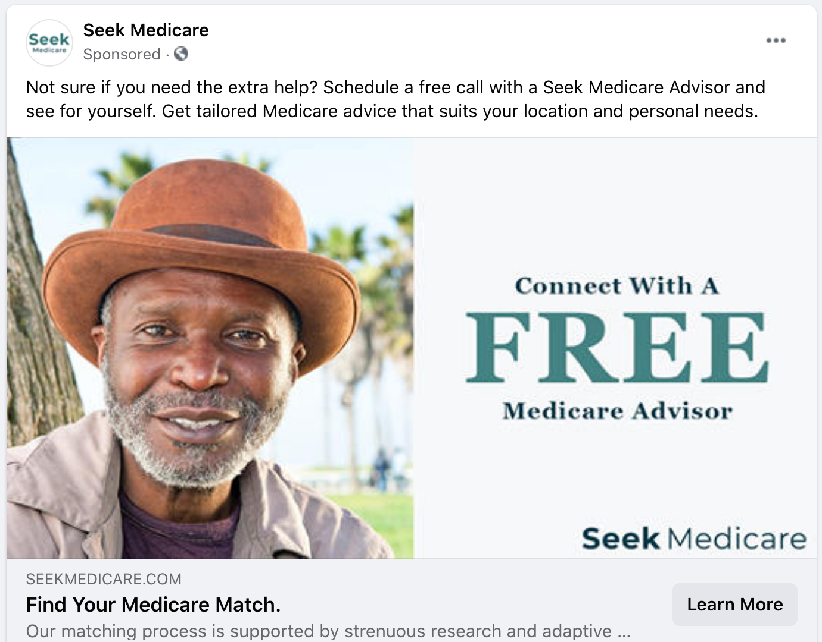

We Bring The Prospects
to You.
SEEK MEDICARE™
Notes:
We do the heavy lifting with direct marketing programs, utilizing lead generation channels and targeted sales strategies.
On a national level, we engage in today’s online marketing tactics such as:
Ads on social media channels.
Search engine marketing.
Deploying scheduled email blasts to our curated list.
Conduct educational webinars on informative Medicare topics to capture leads.
We also follow traditional marketing methods with print ads in senior publications.
Co-market and partner with our Medicare affiliates.
In 2021, we will roll out a national media campaign leading up to the Medicare (AEP) open enrollment periods.

Slide 12
On a national level, we engage in today’s online marketing tactics such as:
Sample Activity 1 (Social Media Advertising)
Sample Activity 2 (Search Engine Marketing)
Sample Activity 3 (Email Marketing)
Sample Activity 4 (Educational Series)
Sample Activity 5 (Oher Traditional Marketing Methods)
SEEK MEDICARE™
Notes:
We do the heavy lifting with direct marketing programs, utilizing lead generation channels and targeted sales strategies.
Our Model indicates that this method boost sales by XX%

Slide 13

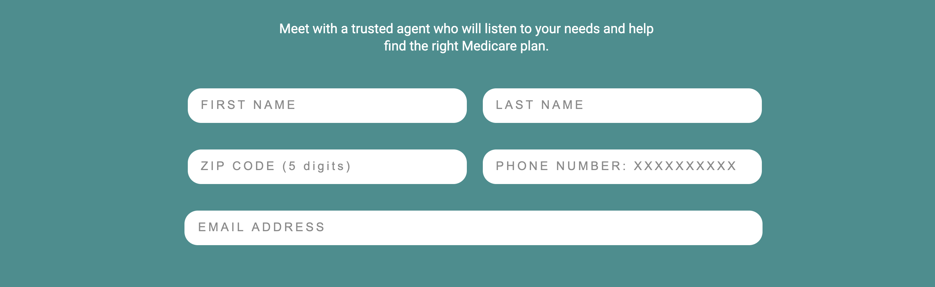
We Pre-Screen Your Prospects.
SEEK MEDICARE™
Notes:
Our team will vet calls and transfer interested and qualified prospects to you. You’ll get access to our client-portal and our easy to navigate software platform that gives you all the tools you need to be successful.
SeekMedicare will deliver your potential prospects with a personalized customer experience online or by phone call.
You will become part of the trusted SeekMedicare Community, along with other SM Agents, you will have access to a wealth of knowledge, the latest research, the governing rules and laws for compliance.

Slide 14

Relax.
We Are Here For You.
SEEK MEDICARE™

Slide 15

Thank You!
SEEK MEDICARE™
www.seekmedicare.com

